Slide 1
MedSys EcoSystem
- Saving lives through MedSys

Slide 2

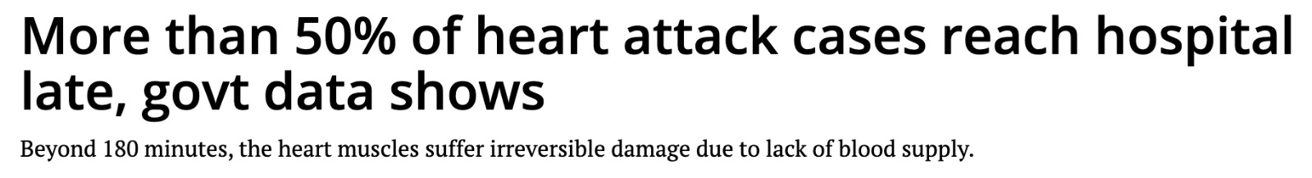
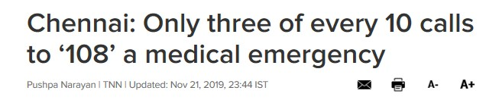
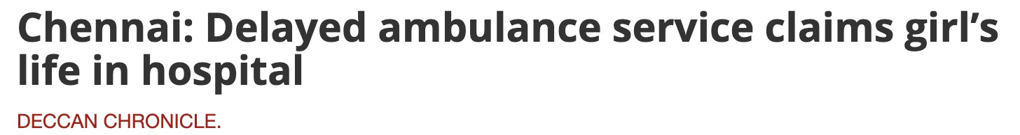
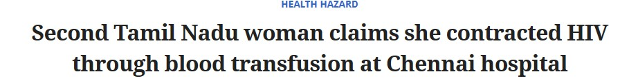
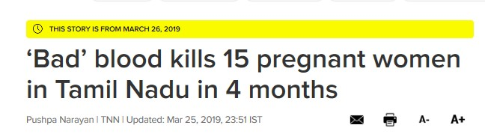
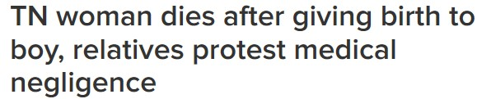
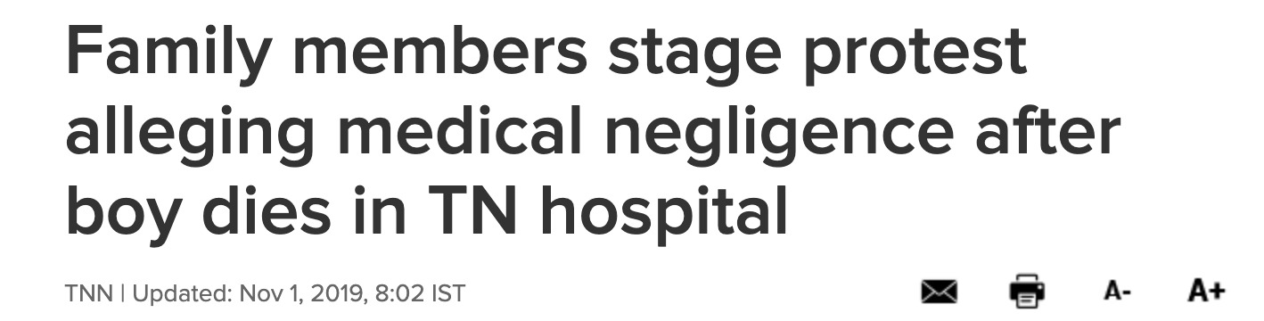
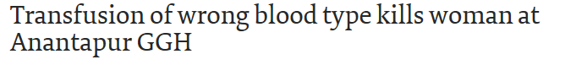
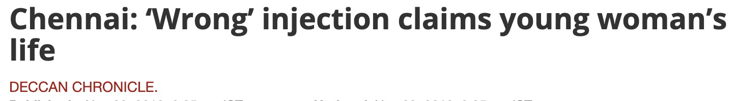
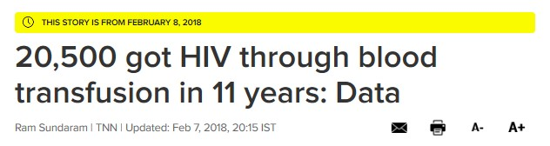

Slide 3
Problem Statement
People residing in small towns in and around Chennai ,Tamil Nadu, India find it difficult to connect with the emergency services and nearby hospitals or blood banks.
Emergency Service - In today’s time, the patient’s life depends on how fast they can be brought under medical supervision and treatment.
Blood Bank - There are widespread fatal incidents in Tamil Nadu owing to incorrect blood transfusions. Blood banks play a vital role in ensuring that the correct and quality blood components are supplied to the patients.
Hospital – There have been cases of medical negligence by providing incorrect medications to the patients hence hospital enterprise ensures utmost medical care for the patients.

Slide 4
There is the need for an effective healthcare system with good facilities and pre-arrival notifications. Needless to say that in order to augment the productivity of a patient’s treatment in an emerging economy such as India, it is essential to create general awareness about the ecosystem

Slide 5
.
MedSys EcoSystem

Slide 6
MedSys EcoSystem
Patient Management System
(Hospital Care)
MedSys
Emergency Medical Services (EMS)
Blood Management System (BloodBank)

Slide 7
Proposed Solution
MedSys EcoSystem is an user friendly Java Swing Application which integrates Emergency Services with the Hospital and the Blood Bank for providing efficient and timely medical services to the patients.
Blood Bank enterprise performs clinical tests on blood and maintains a statistical data on the available blood samples, Hospital enterprise provides prompt warnings when doctor is trying to prescribe a medication which is allergic to the patient, and EMS provides timely response to the patients in case of emergency.
We believe that adopting a common integrated platform and upgrading healthcare value system would benefit the people living in the outskirts of Chennai.
Key Features : Offline Distribution Service, Blood Analytics, Substance UI.
Development Key Features : Junit Testing, Logger, Multithreading, JFreeCharts, Regex.

Slide 8
Approach
Emergency medical providers will help the patient reach the hospital. The hospital and the blood bank will be notified prior time on the patients health and the required blood with the help of emergency caretaker.
The hospital performs diagnosis and treats the patient until recovery while the blood banks provides the required blood needed for the patient.
Timely communication between the enterprises to give medical care to the patients in a quick manner.
Human errors are handled and minimized by the system and notified to the appropriate person in charge.

Slide 9
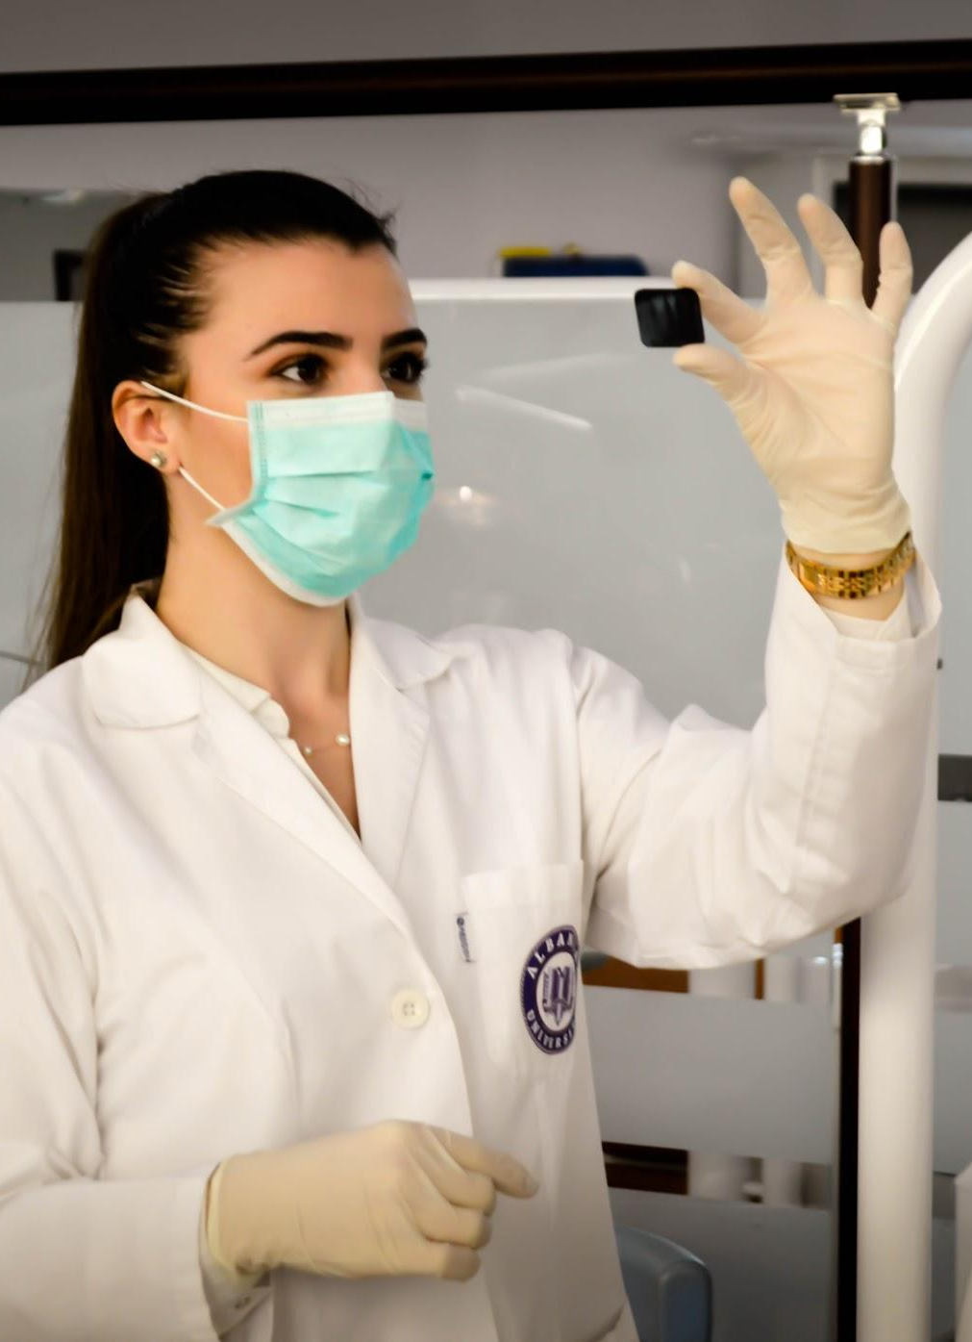
Areas to Focus
The application focuses on performing work requests in all phases of healthcare value chain from ems to hospital and blood bank until patient’s treatment and recovery.
Data management
Procurement – providing A method for inventory tracking
Information sharing & collaboration- sending the patient-related information from the ems to the hospital and to the lab and vice versa.
Involving blood samples for clinical testing.
Provide a dashboard for MedSys to view patients medical situation, allergies, view available blood samples, predominant blood group available in a network.

Slide 10
Maps
our Network

Slide 11
HIERARCHY STRUCTUREarchy str
MEDSYS
CHENNAI
EMS
HOSPITAL1
HOSPITAL2
BLOODBANK1
BLOODBANK2

Slide 12
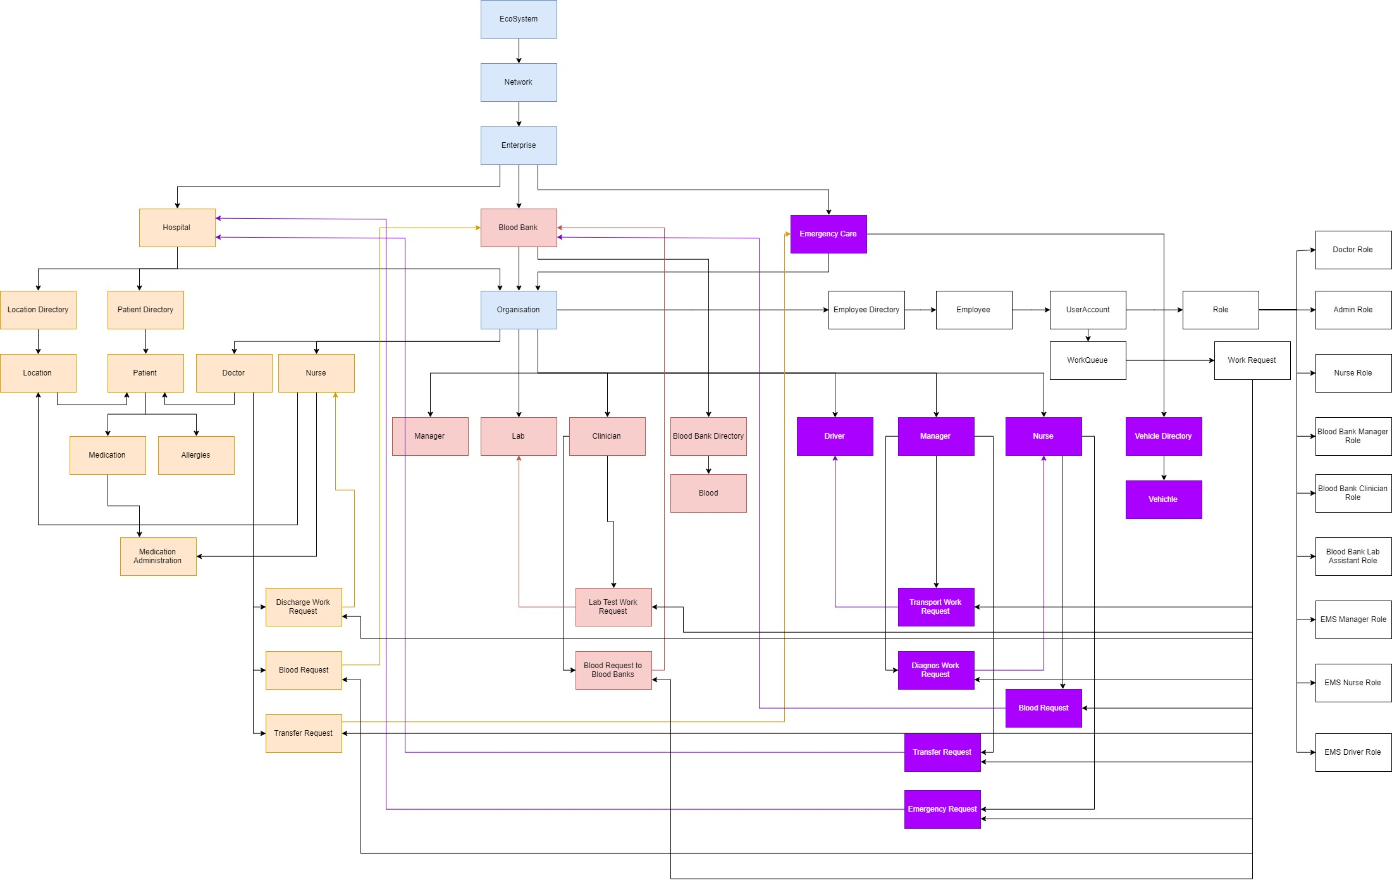
Object Model

Slide 13
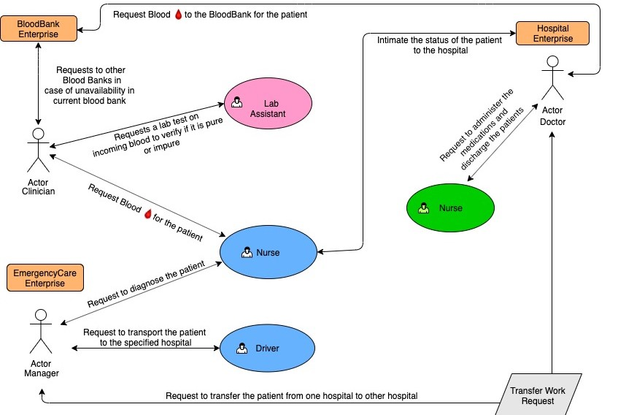
Use Case

Slide 14
Application User Interface
We have used Substance UI for the look and feel of the system with minimalist mild colors .
The reason being the application has to be used in a frequent and consistent manner.
The users need to feel more comfortable to get things done more quickly.
‘The best interfaces are almost invisible to the user’

Slide 15
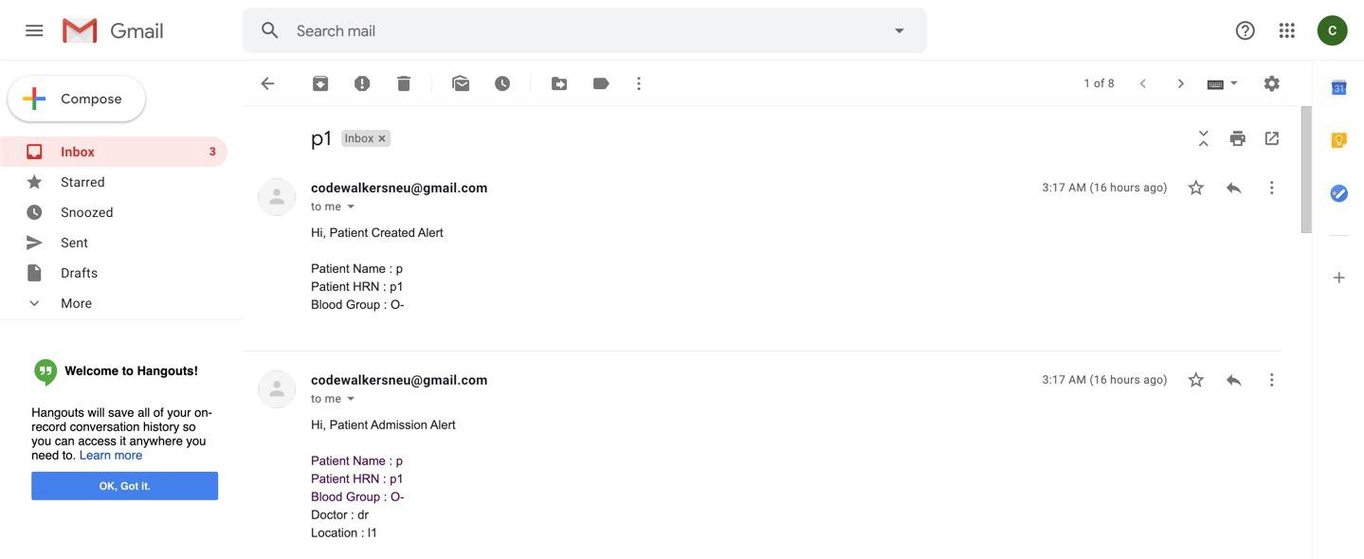
Key Features
Offline Distribution System :

Slide 16
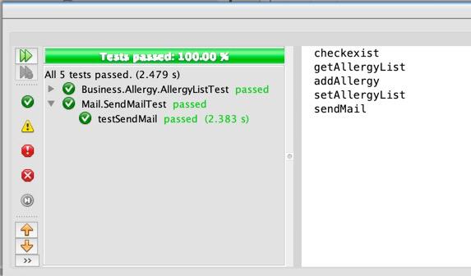
Junit Testing :

Slide 17
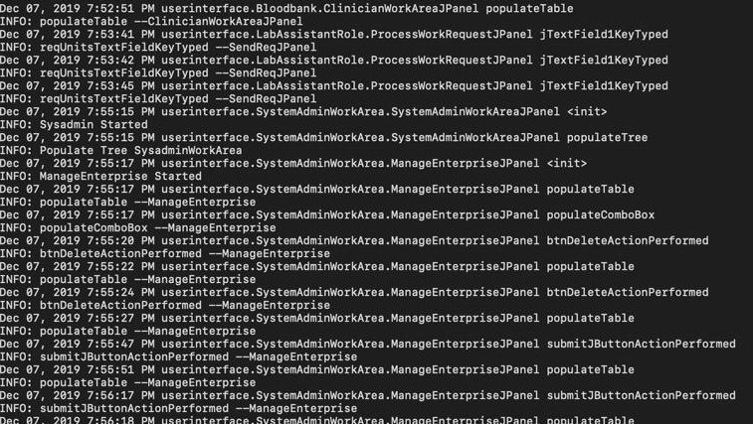
Logger :

Slide 18
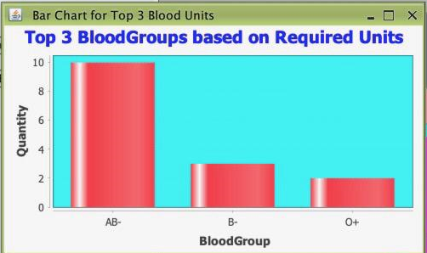
Statistical Analysis
Bar Chat :

Slide 19
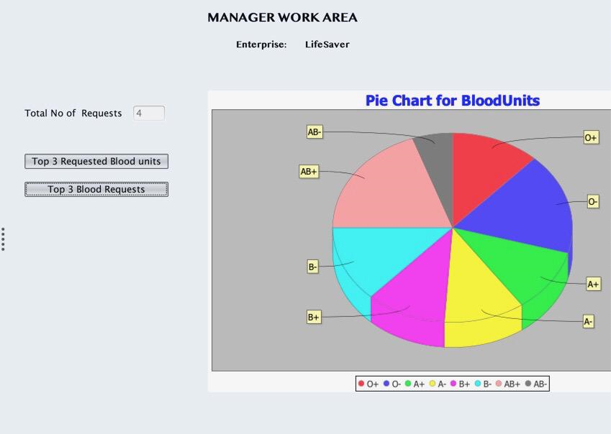
Pie Chart :

Slide 20
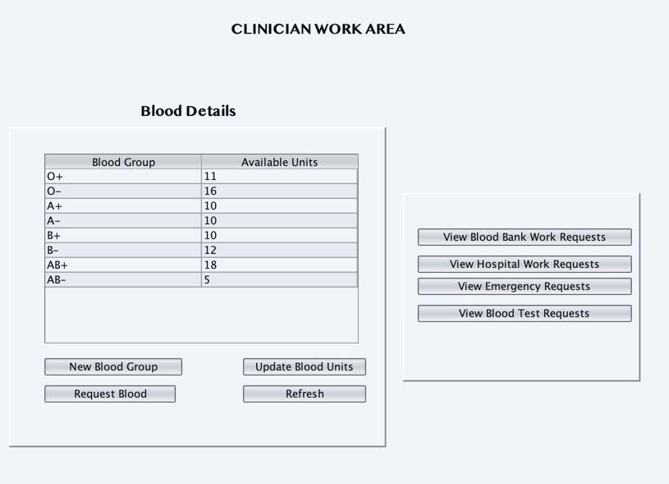
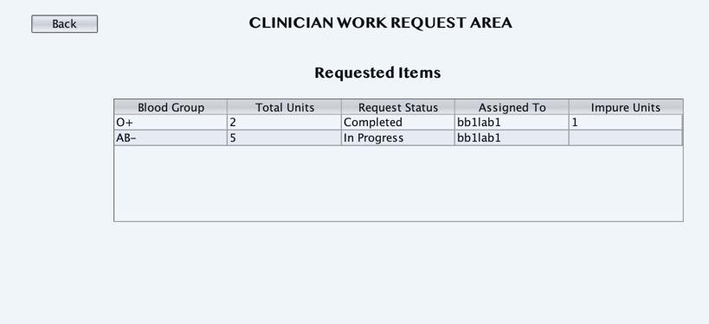
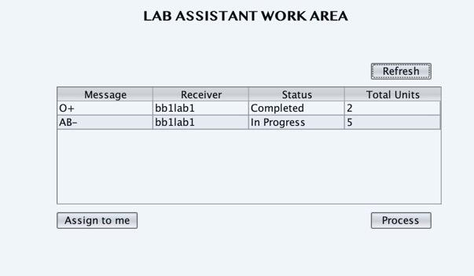
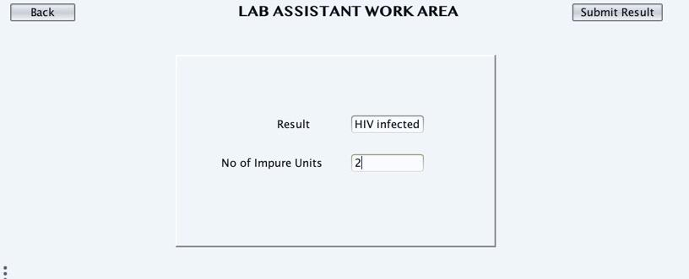
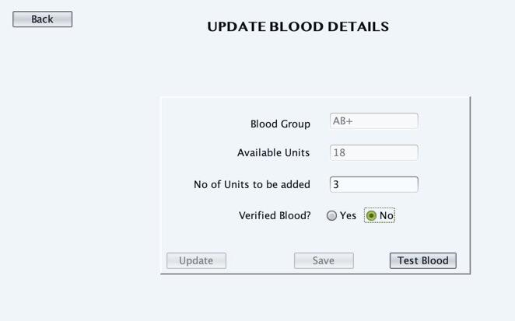
Work Flow
Enterprise – Blood Bank
LabTestWorkRequests – To Verify the
Blood purity

Slide 21
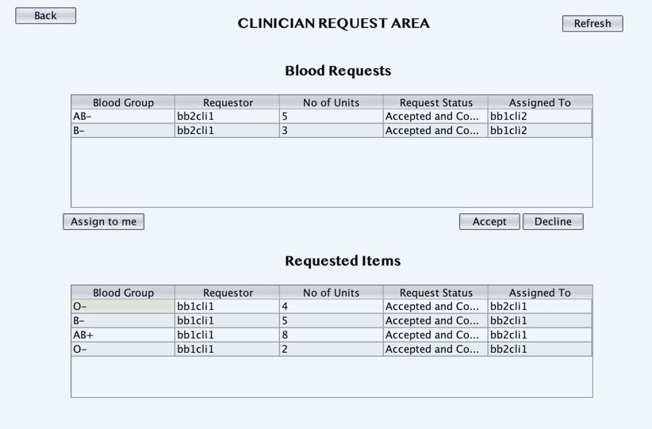
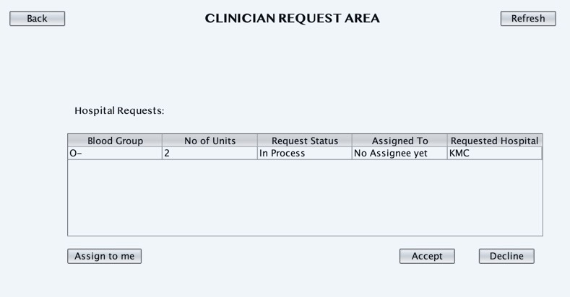
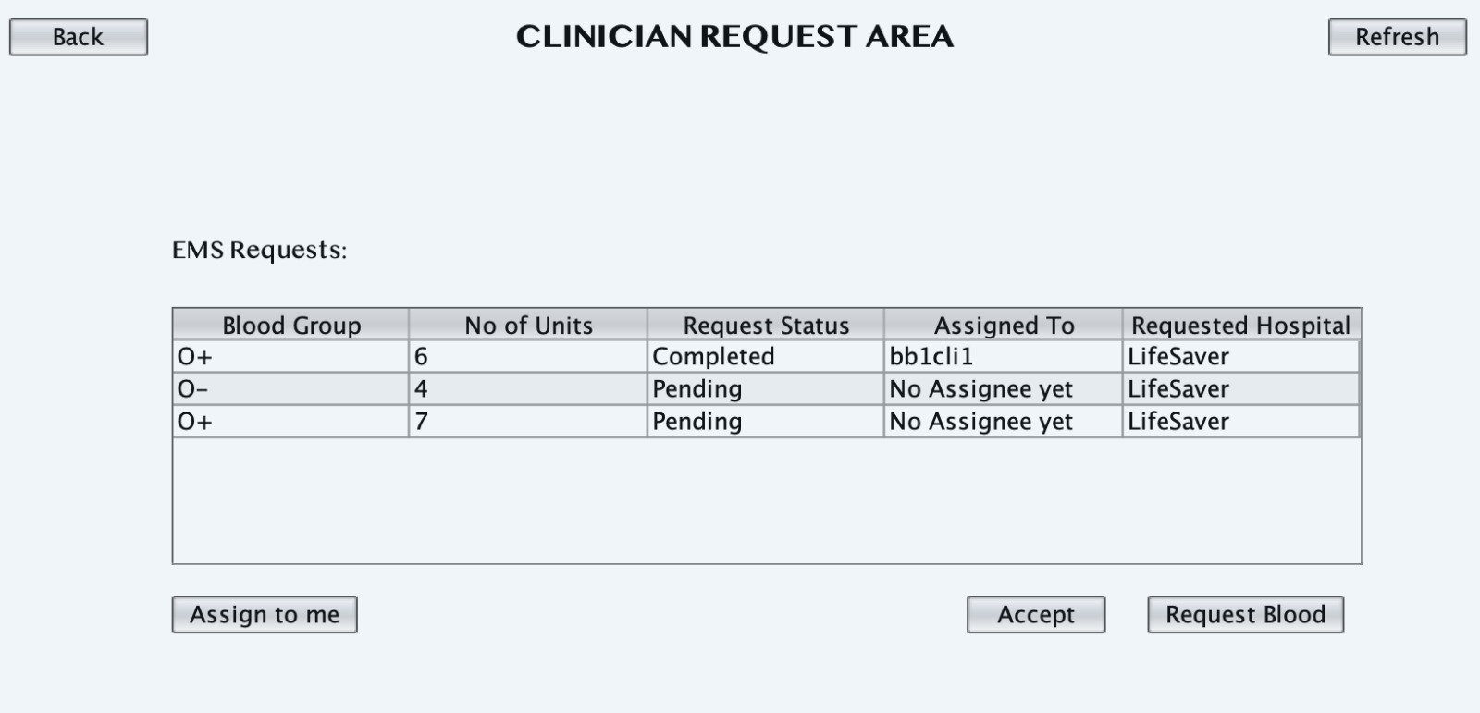
Enterprise – Blood Bank
Blood Requests with other Blood Banks
Blood Requests from Hospitals

Slide 22
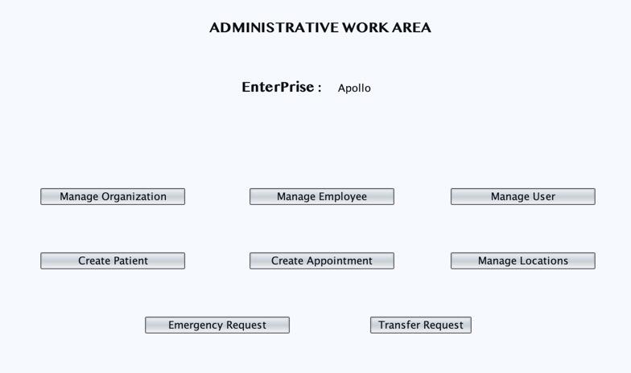
Enterprise - Hospital
Admin can add patient, create locations and assign nurses to the locations.
Appointments are created by the admins which connects the doctor, nurse and the patients.

Slide 23
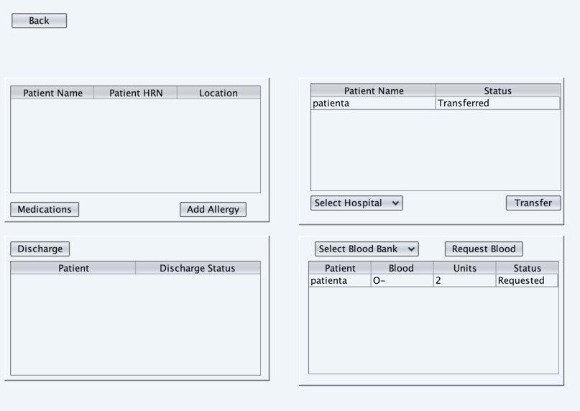
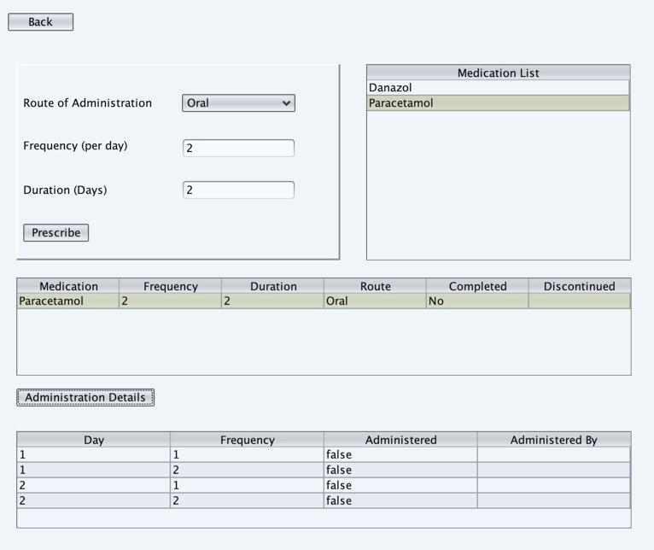
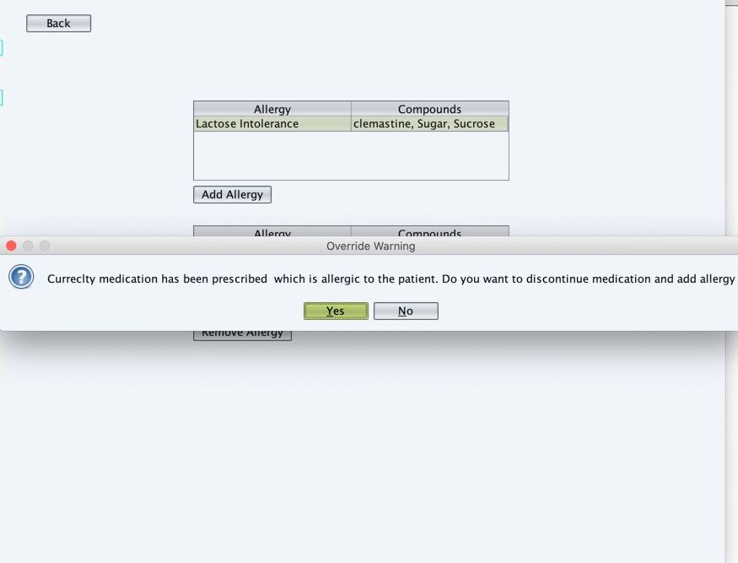
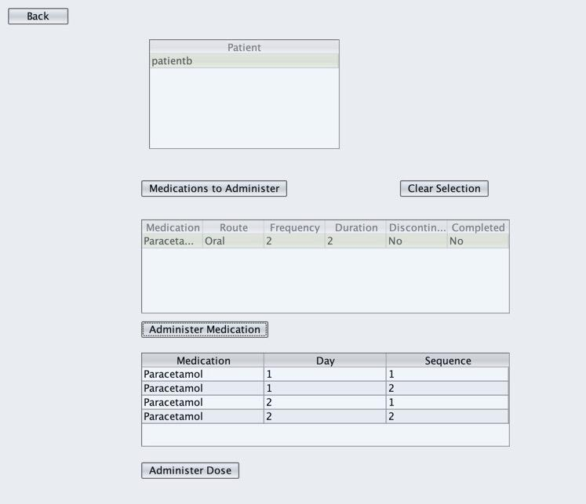
Hospital Work Flow (contd)

Slide 24
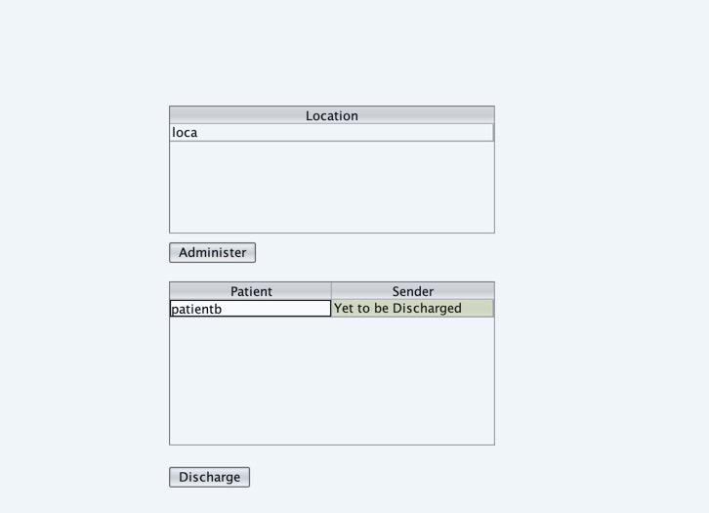
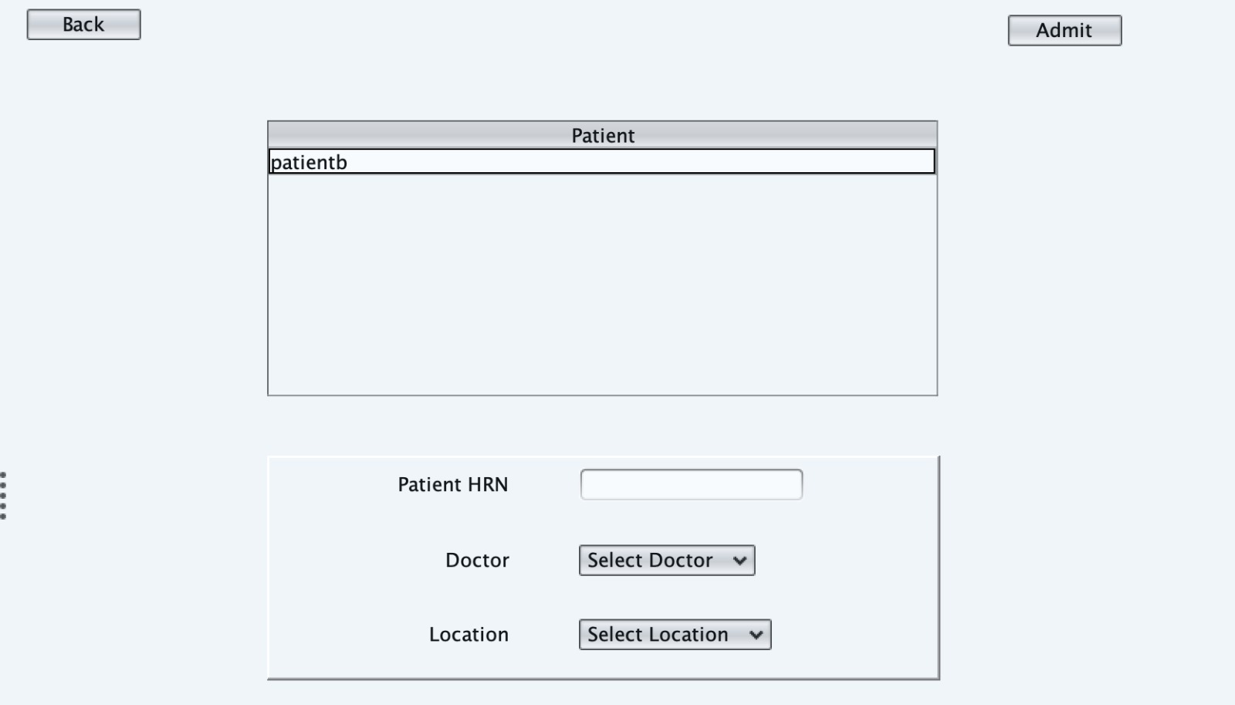
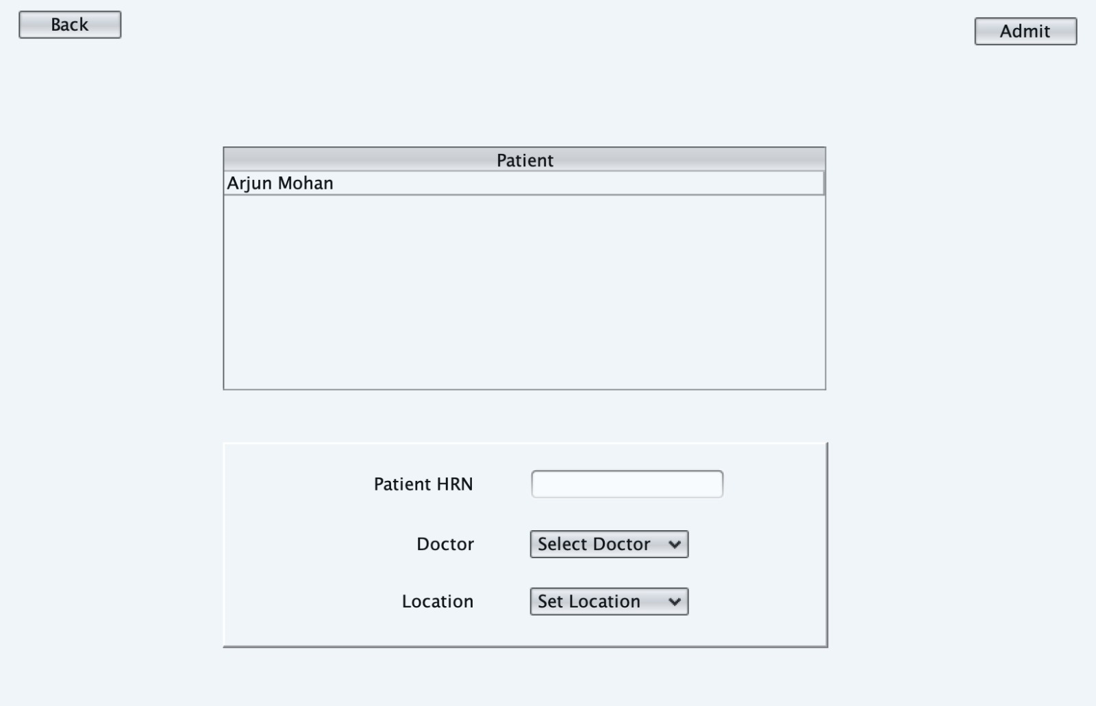
Hospital Work Flow (contd)
Discharge Requests
Transfer Requests
Emergency Requests

Slide 25
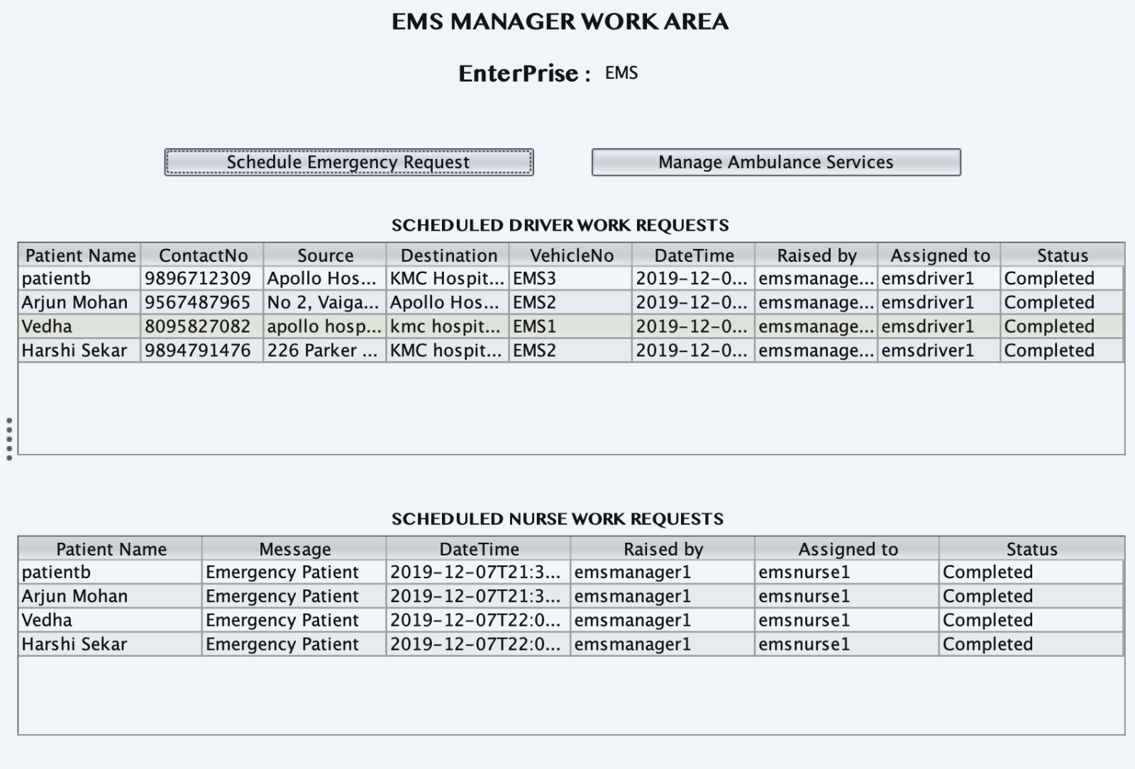
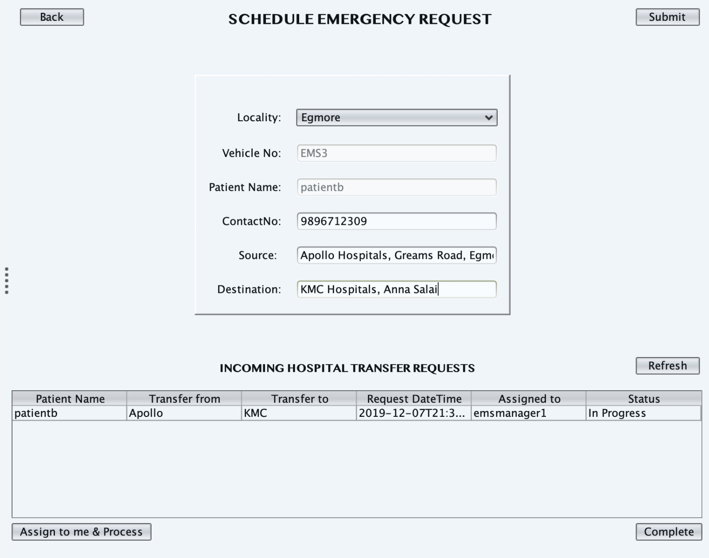
Work Flow
Enterprise - EMS
EMSManager Scheduled work requests to EMSDriver and EMSNurse
EMSManager Scheduling a transfer work request to EMSDriver and EMSNurse

Slide 26
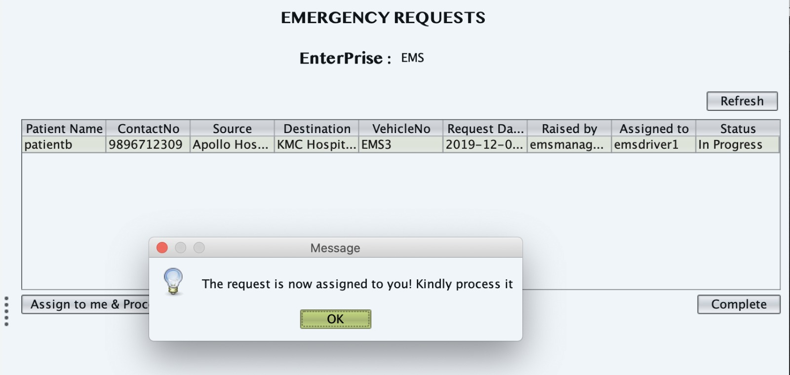
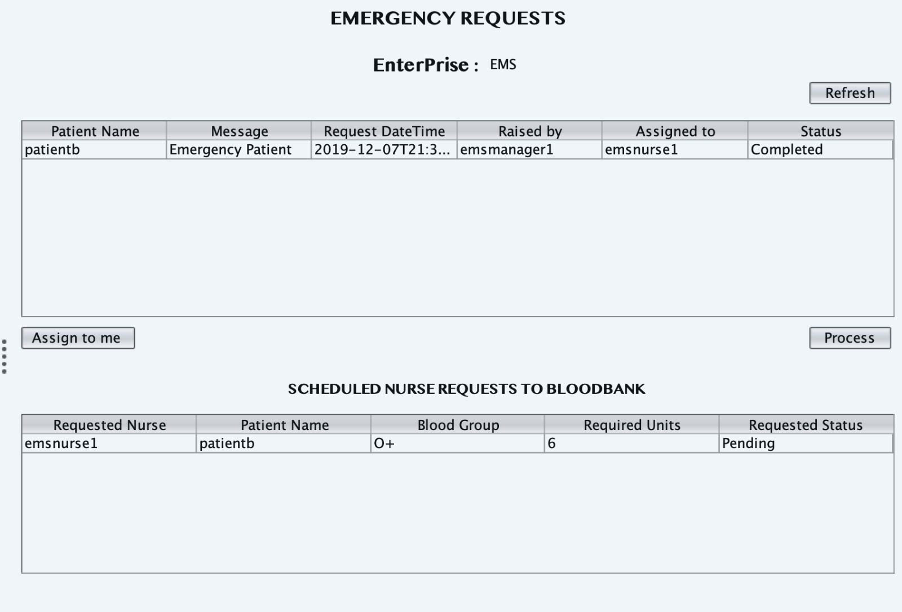
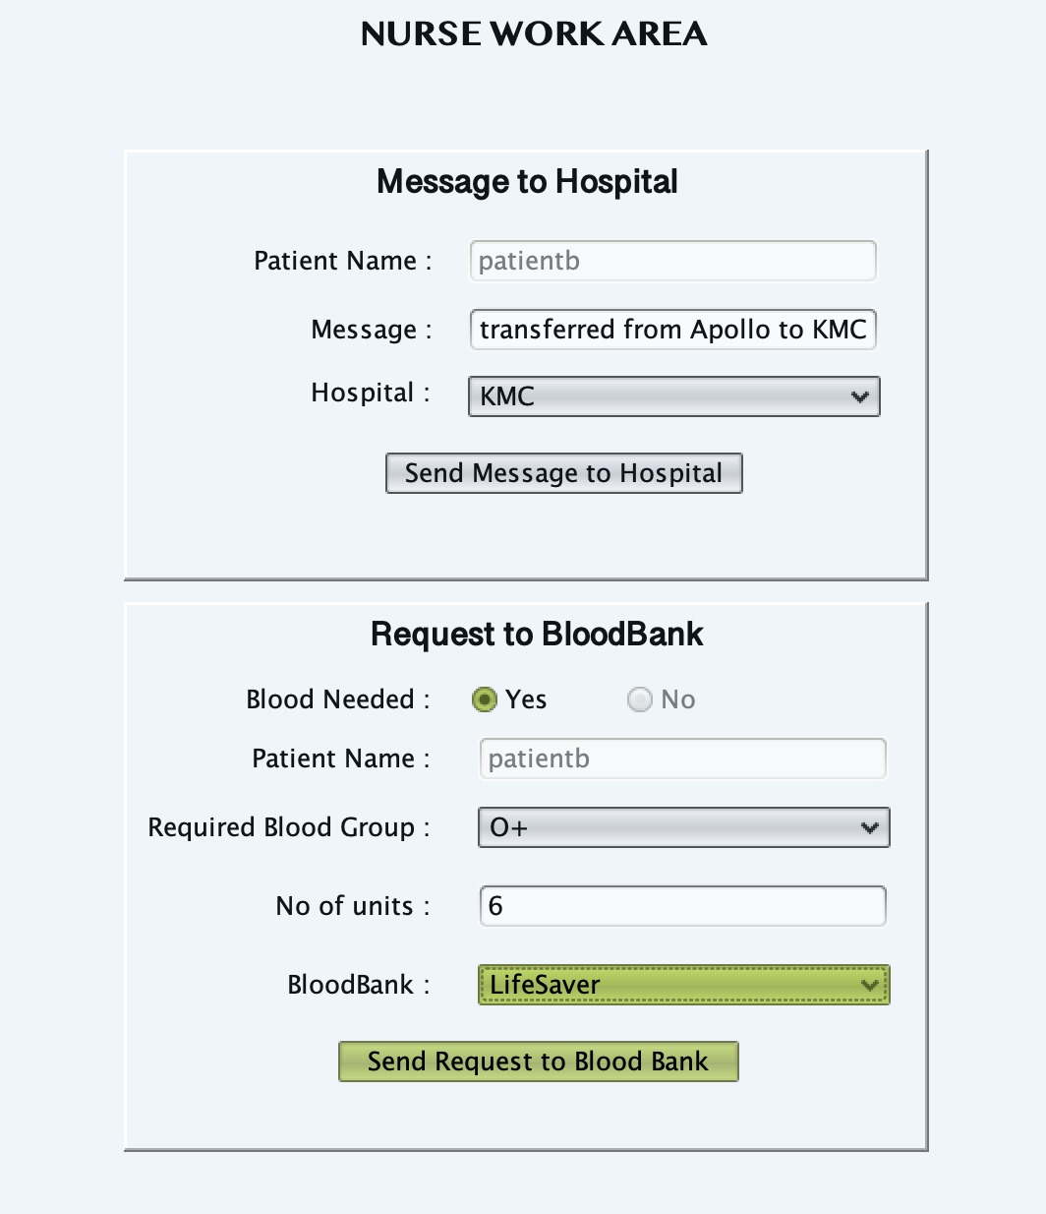
Enterprise - EMS
Driver Work Requests
Nurse Work Requests
Nurse Process Work Request Area

Slide 27
Future Scope
We will predict the medications to be given to the patient based on the medications that has been given to diagnose allergies.
Automated request to the blood banks when the threshold is met.
Ability for the enterprise to extend medical services such as mobile hospital feature, increasing hubs around the country
We can integrate this application with mobile apps such as swiggy, ubereats and we can provide a warning to the users to avoid certain foods.
Using the barcode reader to avoid administration of incorrect medications.
.
Based on a patient’s gene and medical history, predict the possibility of a disease to occur.

Slide 28
Benefits
We believe that adopting a common integrated healthcare value system would benefit patients with a improved medical care.
safer and cost effective healthcare can be provided to millions of patients across the country.
Keeping track of inventory across multiple enterprises helps in prompt treatment to patients.

Slide 29

Special Thanks to Dr.Kal Bugrara for his valuable knowledge and guidance.
Special Thanks to Mr.Kinnar and all the other TA’s for helping us throughout this semester.

Slide 30
Thanks!

